Slide 1
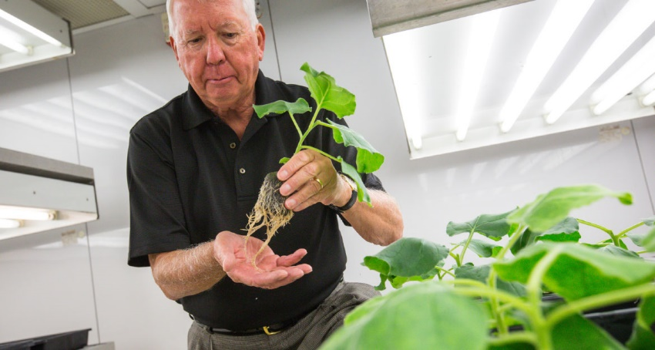
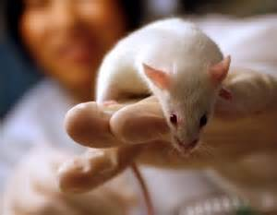
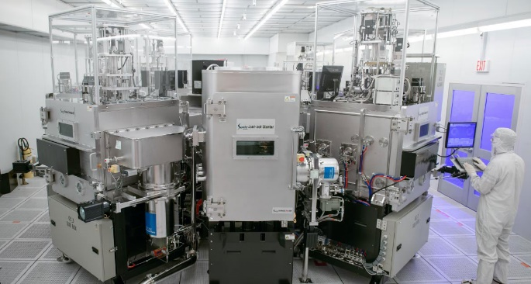
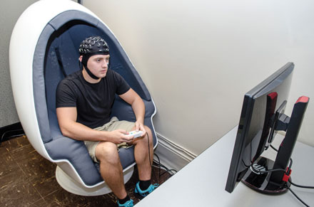
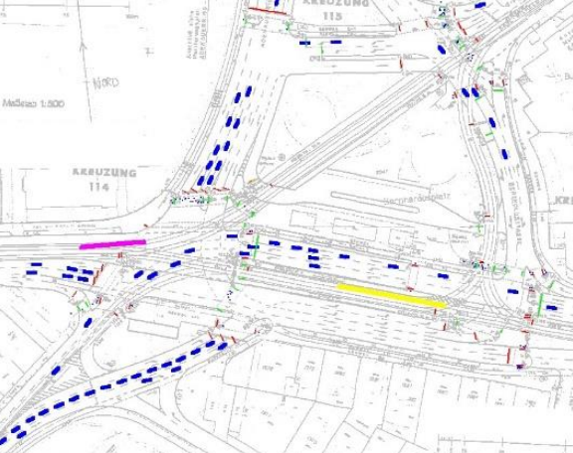
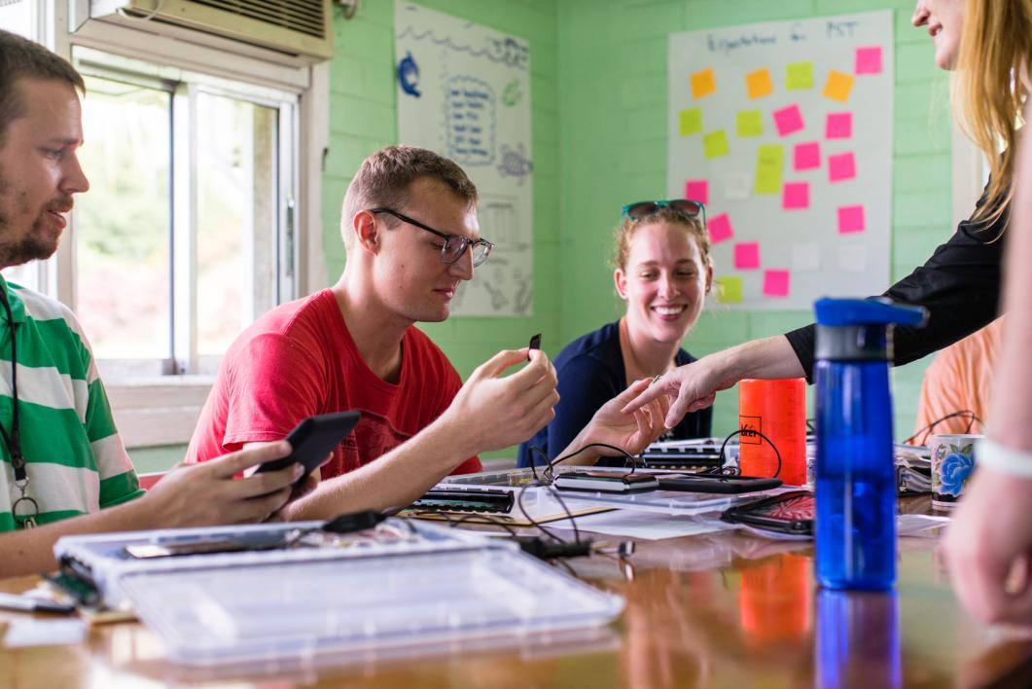
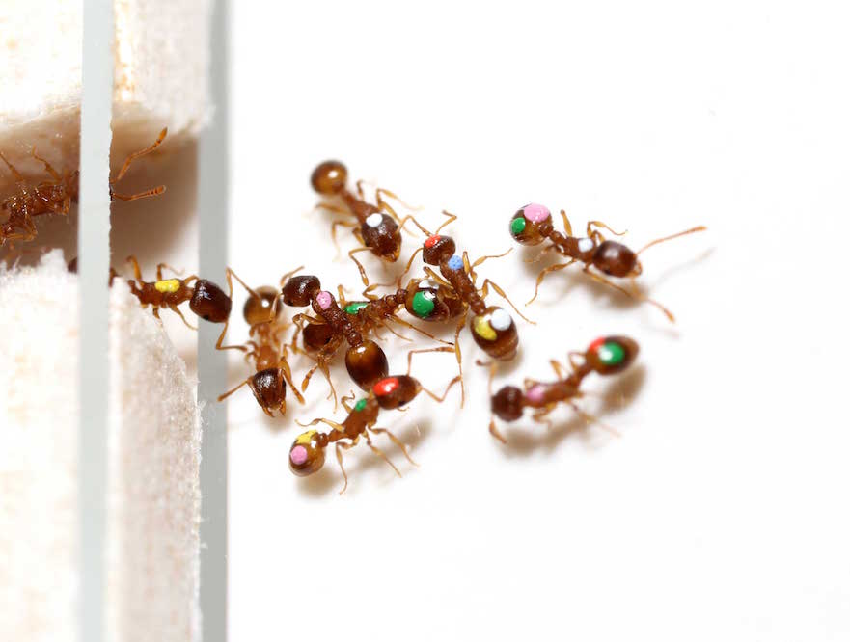
Department of Human Research @ NU

Slide 2
About the Presenter
Erik Williams, CIP
Senior Coordinator
er.williams@northeastern.edu
Previous experience:
University of Wisconsin
Arizona State University
Virginia Commonwealth University

Slide 3
Exempt 1 or “Educational Research” considerations

Slide 4
Exempt 1
FERPA
FERPA is a federal law protecting academic data like:
Grades
Homework
Papers… etc
FERPA requires consent:
Usually prospective affirmative consent as part of the IRB Informed Consent Process.
Can be affirmative consent at the start of the semester.
FERPA Consent ≠ IRB Consent or Approval!
NU Registrar responsible for implementation. If unable to obtain prospective consent from participants for permission to use their academic data, consult with Ingrid Nuttall i.nuttall@northeastern.edu for now.

Slide 5
Exempt 1
Research on your own students/Extra Credit
A status relationship – can also apply to students, employees, or family.
Potential for perception of coercion.
Consider this when designing recruitment/consent processes.
High risk or high burden projects are of more concern.
Extra Credit:
Have equitable (in time and effort) non-research alternative.
Participants should be able to withdraw and still receive credit.
Credit small in proportion to a student’s overall grade.
Documentation of credit does not jeopardize anonymity.

Slide 6
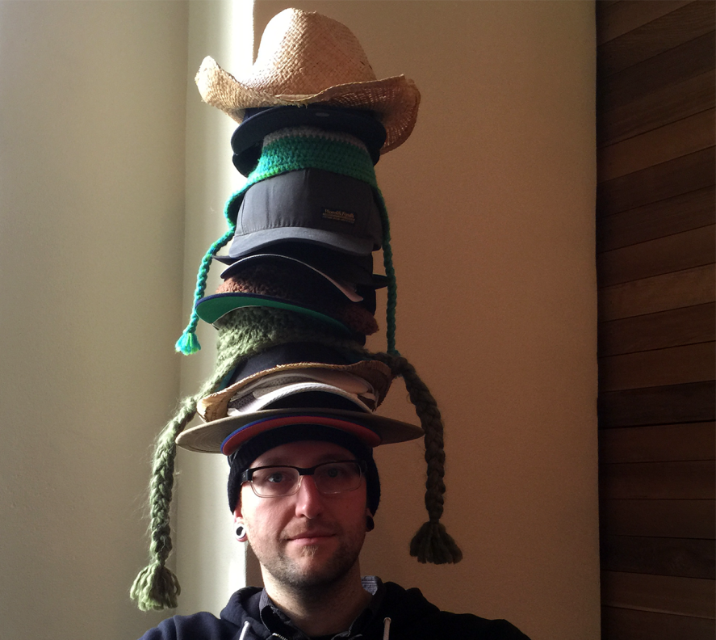
Exempt 1: Dual Roles as Instructor and Researcher
The Multiple “Hats” you switch between:
NU Instructor
NU Researcher
Volunteer
Parent
Mentor
Second
University
Healthcare Provider
Friend
This Photo by Unknown Author is licensed under CC BY-SA

Slide 7
Exempt 1: Mapping activities to disentangle dual-role responsibilities
The biggest regulatory hurdle is research that isn’t framed correctly:
Coursework Only
Activities that are being done for ONLY the course. If the research were not occurring, these activities would still take place.
Coursework Used for Research
As Secondary Data
Activities are being done for coursework that you also want permission to analyze or re-use as secondary data for research purposes. If the research were not occurring, the coursework would still take place.
Research
Only
Activities are being done for only research purposes.

Slide 8
Exempt 1
Example project design
A study wishes to examine pre/post how well an instructional strategy the department is implementing works. To do this, we will need test scores, qualitative analysis of final term papers, and pre/post surveys to collect data that can’t be found in coursework.
Bucket 1 | Bucket 2 | Bucket 3
The instructional strategy is being implemented by the department. If this research study isn’t approved, we will be doing it anyhow. | While the tests and term papers are being implemented by the department and will occur if this study isn’t approved, I also want to get permission to use them for research data. | The pre/post surveys serve no academic purpose and are only being done if this study is approved. So, the surveys are research-only procedures.
Teaching the class is an “instructor” only hat. | Collecting + grading the tests/papers is under my “Instructor” hat. Asking permission to also analyze them for research purposes is my “researcher” hat. | Asking my students to complete the surveys is my “researcher” hat.

Slide 9
Exempt 1
Example project design: implementation
Example consent form language:
“We are asking you to take part in a research study to see how our well our new lesson works. This new lesson is being used across all courses. If you agree to take part in this research study about the lesson, we will ask you to complete a 5 minute survey at the start of the semester and a 5 minute survey at the end of the semester. The surveys will ask some questions about…. We are also asking for your permission to use your final test grades and to analyze your final papers you will complete as part of the class. Your academic data is protected by FERPA and, as such, we need your permission to use this data for research purposes.
We recognize that you may be concerned that you might feel pressured to take part in the research study as the instructor is also grading you. To mitigate this, we have designed the study so your instructor will not know who did and did not choose to take part. A second research assistant will collect all the data and will create a data set that your instructor will only have access to after grades have gone out.”

